Slide 1

Graduate School Primer

Slide 2
Is Graduate Study Right for Me?
Why do I want to go?
Am I ready to?
  Attending Class
  Reading
  Writing
  Public Speaking
  Research
  Work Experience
Is this realistic for me?
Notes:
Why do I want to go?
Clarify goals and objectives
guides later decisions regarding level, school, discipline
Do I have the skills?
Attending Class
9-12 credit hours
small classes (6-20)
More expectations, can’t hide, more intense relationships with peers
Class is a forum for discussing things learned outside of class – independent learning required
Significant competition, small fish in big pond
Reading
Extraordinary amount of reading – several textbooks and journal articles are required per class
More critical reading than just textbook consumption
Writing
Significant writing
Primary means for assessing knowledge
Paper per class
APA mastery is required
Public Speaking
class discussion and presentation
Research
Significant time at library combing literature
Inputting and analyzing data
significant course work in stats and design
Work Experience
Practicum experience
Realities –
Admission standards
3.11 minimum to gain consideration doc
2.92 masters
1066 minimum GRE doc
952 masters
Research, experience, course work, extra-curriculars
Application process
Expensive - $45 application fee plus transcripts and test scores
Tedious - gathering and documenting information
Costs of Education (2005 data)
4-7 years for doc
2-4 years masters
Strongly urge not to work even part-time
Mean cost is 10G res, 15G non-res (public 5G – private 20G)
5-9G res nonres masters, 3.5-15G public private

Slide 3
Types of Grad Programs in Psychology
PhD
Masters (M.S. or M.A.)
PsyD
Notes:
Why do I want to go?
Clarify goals and objectives
guides later decisions regarding level, school, discipline
Do I have the skills?
Attending Class
9-12 credit hours
small classes (6-20)
More expectations, can’t hide, more intense relationships with peers
Class is a forum for discussing things learned outside of class – independent learning required
Significant competition, small fish in big pond
Reading
Extraordinary amount of reading – several textbooks and journal articles are required per class
More critical reading than just textbook consumption
Writing
Significant writing
Primary means for assessing knowledge
Paper per class
APA mastery is required
Public Speaking
class discussion and presentation
Research
Significant time at library combing literature
Inputting and analyzing data
significant course work in stats and design
Work Experience
Practicum experience
Realities –
Admission standards
3.11 minimum to gain consideration doc
2.92 masters
1066 minimum GRE doc
952 masters
Research, experience, course work, extra-curriculars
Application process
Expensive - $45 application fee plus transcripts and test scores
Tedious - gathering and documenting information
Costs of Education (2005 data)
4-7 years for doc
2-4 years masters
Strongly urge not to work even part-time
Mean cost is 10G res, 15G non-res (public 5G – private 20G)
5-9G res nonres masters, 3.5-15G public private

Slide 5
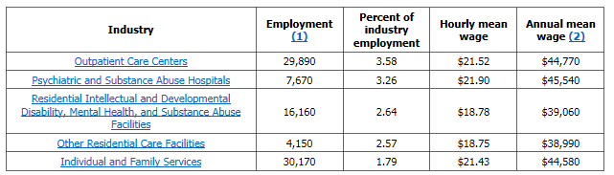
Master’s level

Slide 6
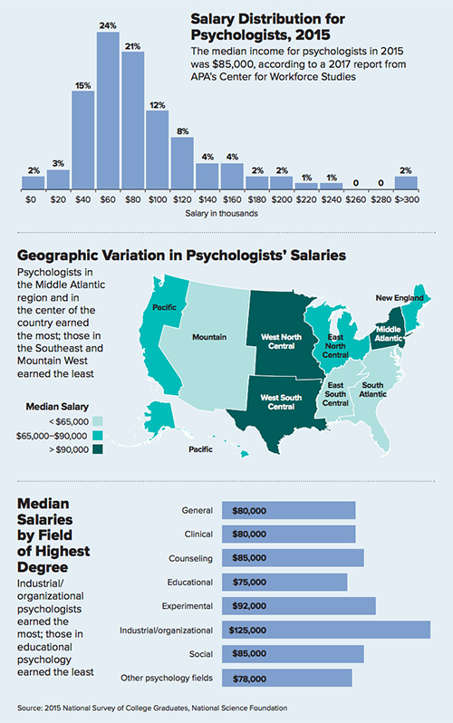
Doctoral Level

Slide 7
Doctoral Level

Slide 8
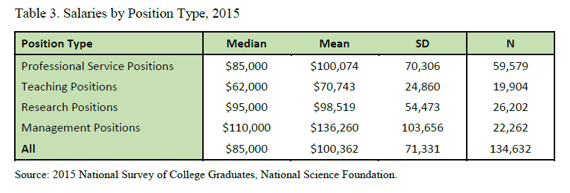
Doctoral Level

Slide 9
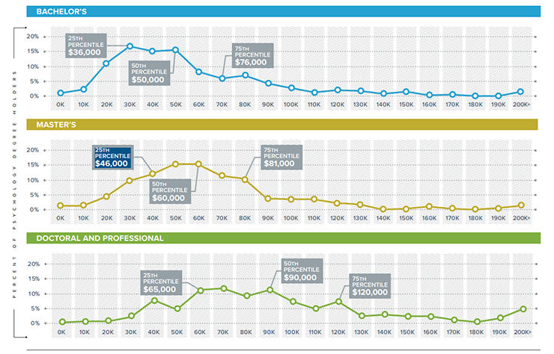
Psych Degree Earnings (APA 2023)

Slide 10
Applying to Grad School

Slide 11
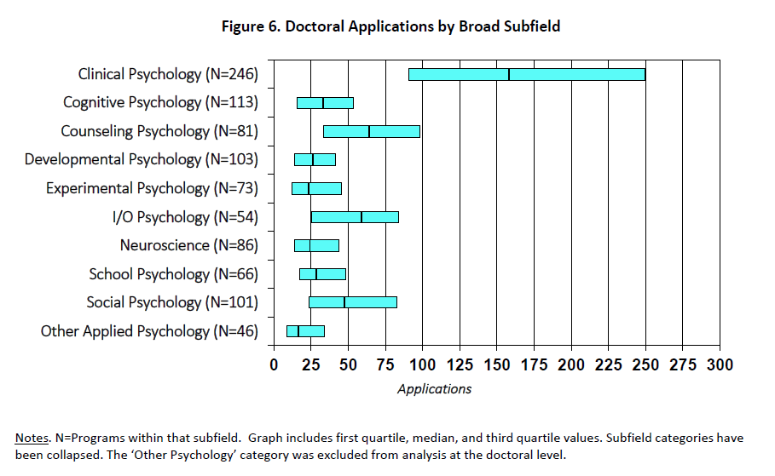

Slide 12
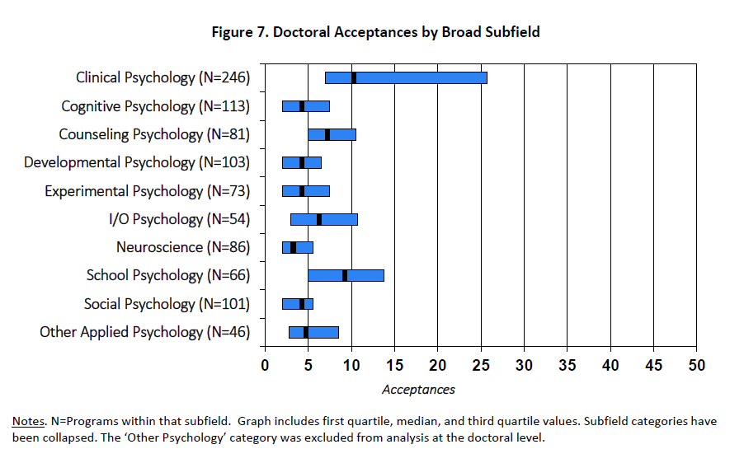

Slide 13
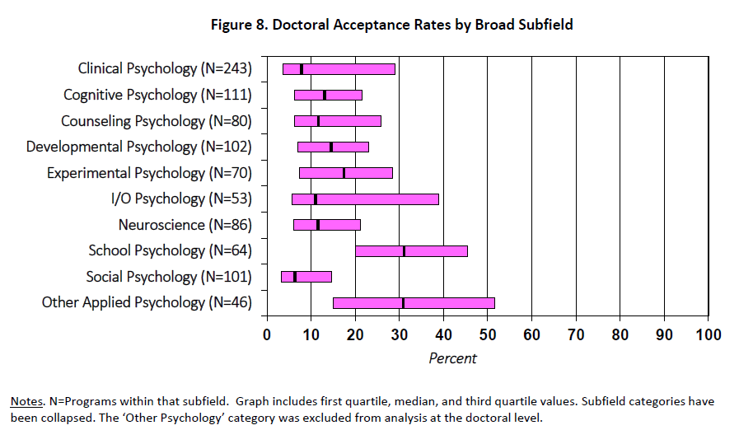

Slide 14
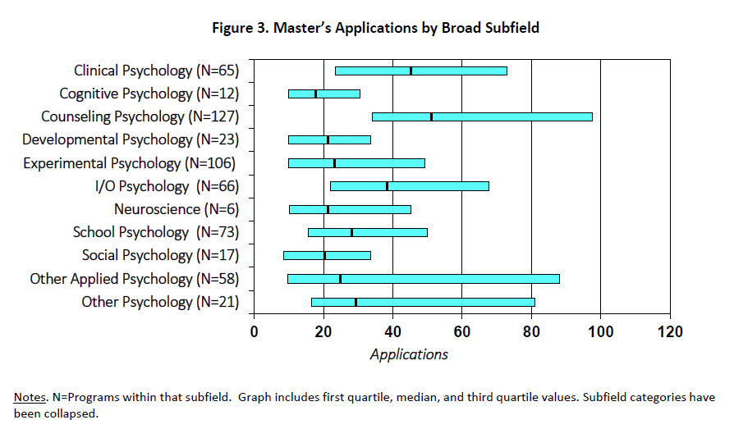

Slide 15
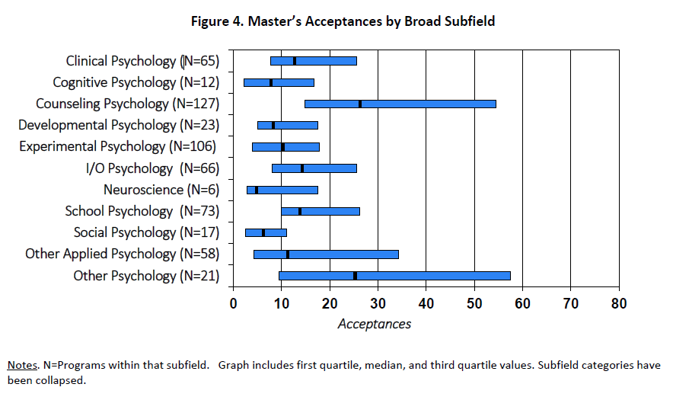

Slide 16
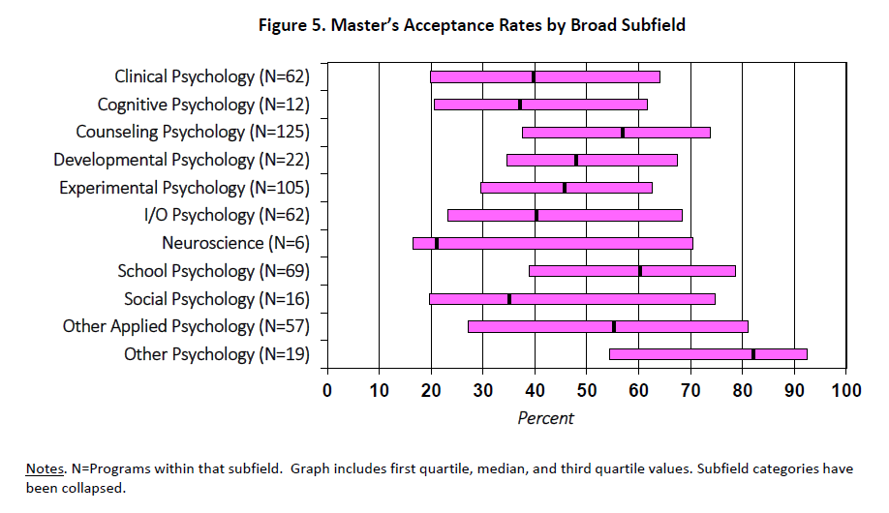

Slide 17
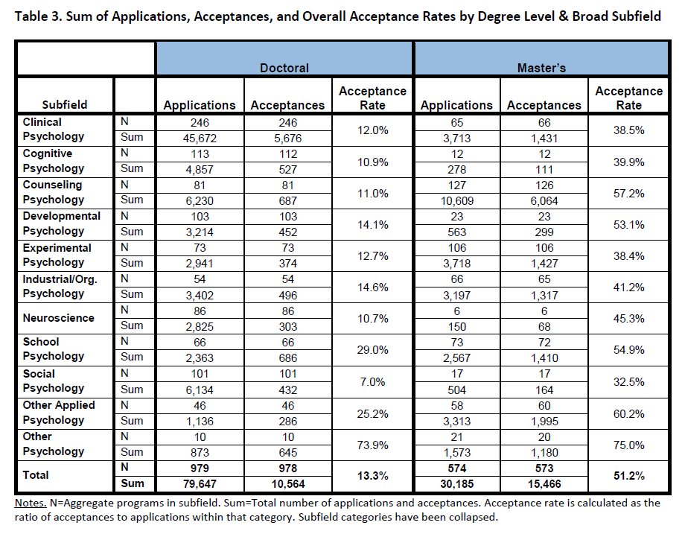

Slide 18
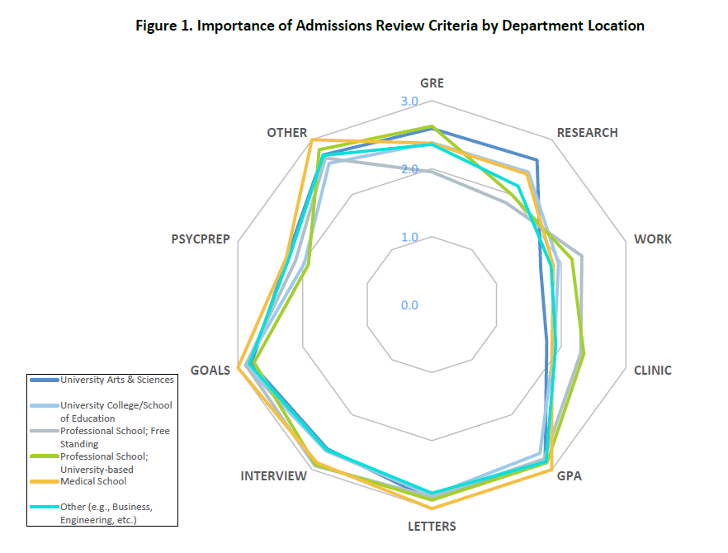

Slide 19
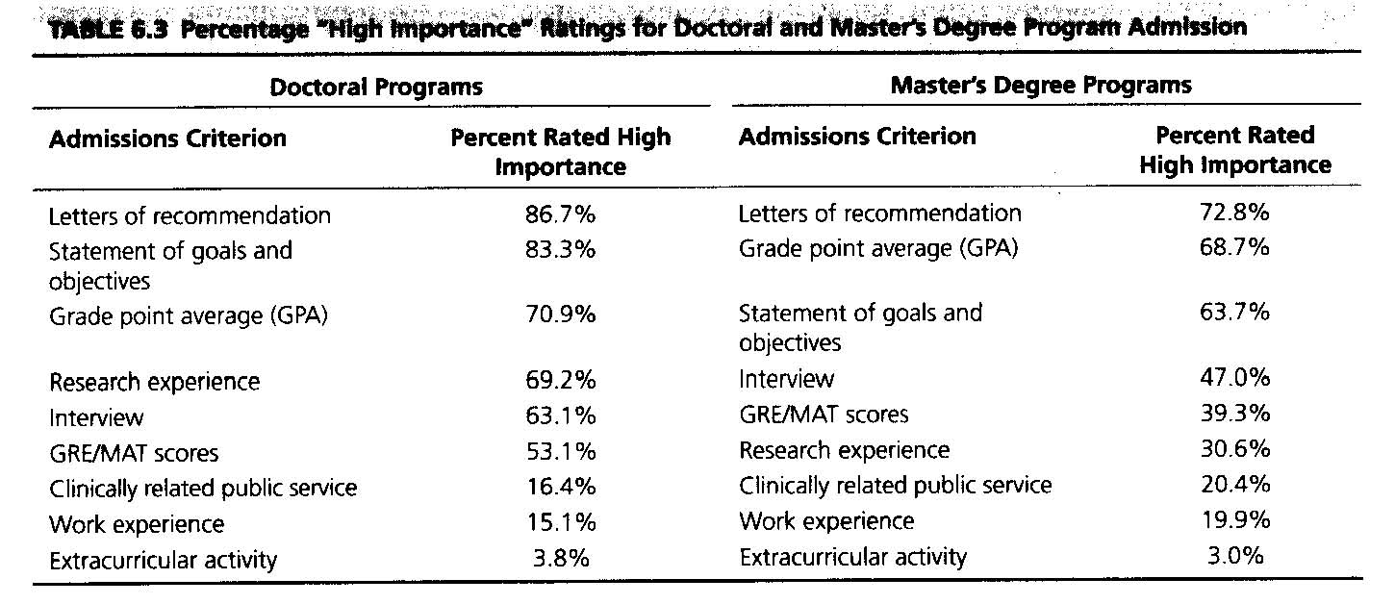
Most Important for Admission

Slide 20
Notes:
Norcross et al. 2005

Slide 21
Secondary Criteria (Tie Breakers)
Research Experience
Publications?
Conference Presentations?
Assisting in a lab?
Match between skill/interest and program
Identifying a specific faculty member you want to work with
Clear and focused statement of purpose

Slide 22
Matching
Know your desires
Know your status
Know your preferences
Identify programs
Apply
Notes:
Preferences – considerations
faculty interests
specialty populations
accredited
location
finances
mentoring
Identify
Grad Study – APA publication, school websites
Start by identifying area of concentration and degree offering
Need some standardized data collection form to get all pertinent data
Request information early – especially information regarding finances
If you talk directly with someone, DO NOT ask something that you could find the answer to easily
Strong bets - grades, scores and coursework are above the median, strengths in letters, experience and/or other
Good bets – coursework, grades and scores exceed the minimum
Long shots – objective ratings fall below the lowest level of desire – minimum, preferred, median and have strong compensatory non-objectives
Don’t try it
10 unless applying for popular area – clinical
5/10 should be good bets, at least 3/10 strong bets,

Slide 23
Application Timeline
Exploration
Summer 2021
Research/Exp
Fall 2020 – Spring 2021
Take GRE
Summer 2021
Application Window
Aug 2021 – April 2022
Anticipated start:
Aug 2022
ASAP
Exploration/Research
Fall 20-Spring 21
Continued Research/Exp
Summer 2021
Take GRE
Nov/Dec 2021
Apps Due
Feb 2022
Interviews
Aug. 2022
Anticipated Start

Slide 24
Master’s then PhD?
Good idea, especially if not sure about grades
Having a Master’s degree same or related field greatly improves chances of getting into PhD
What type of Master’s degree depends on what you want to do
  Clinical M.S. → Clinical PhD
Many terminal MS programs are designed to prepare students for further study at the doctoral level

Slide 25
Resources
Overview of graduate schools
  https://www.apa.org/education/grad/applying
Incredible overview of the decision-making process
  https://www.apa.org/education/grad/application-video-series
Specific detailed program information
  https://gradstudy.apa.org/?_ga=2.231468767.1989200163.1605646863-1839066701.1602773200

